Slide 1
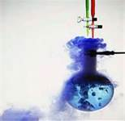
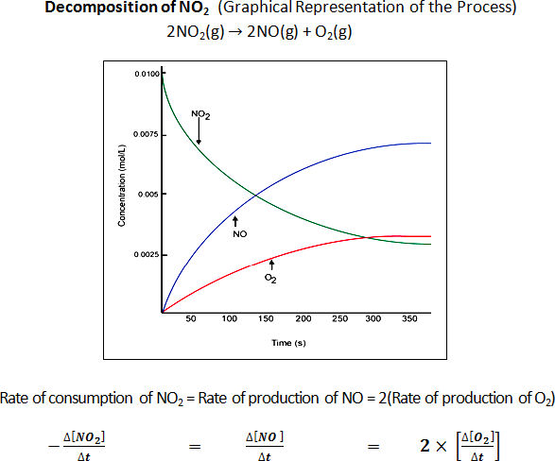
Chemical Kinetics

Slide 2
Rates of Reactions
When we speak of fast or slow, what do we mean?
Any process can be described in terms of an amount of change over a period of time – a rate.
When we use think about rates of chemical reactions, we have to use chemical units with time in some way.

Slide 3
Fe (s) + O₂ (g) → Fe₂O₃
This is a skeleton equation. What are the coefficients?
1 mole of Fe is converted into iron III oxide at the rate of 0.5 mole iron/year.
Is this a fast or a slow process?
What exactly is going on when oxygen reacts with iron?

Slide 4
Chemical kinetics is the field of chemistry that is concerned with the speed of chemical reactions (reaction rates) and the way these reactions occur.
Rates of reactions can be understood by considering the conditions of chemical reactions:
- temperature
- concentration of reactants
- surface area
- presence or absence of a catalyst
- the nature of the reactants

Slide 5
A 1-cubic-centimeter cube of sodium reacts more rapidly in water at 25°C than does a 1-cubic-centimeter cube of calcium at 25°C. The difference in rate of reaction is most closely associated with the different
surface area of the metal cubes
nature of the metals
density of the metals
concentration of the metals

Slide 6
Why do chemical reactions occur?
Chemical reactions occur because of collisions between atoms, ions, or molecules of sufficient kinetic energy at the proper orientation.
New chemical bonds are established when these effective collisions occur.
Any factor that increases the number of effective collisions increases the rate of a chemical reaction.
This view of chemical change has come to be known as collision theory.

Slide 7
Which event must always occur for a chemical reaction to take place?
formation of a precipitate
formation of a gas
effective collisions between reacting particles
addition of a catalyst to the reaction system

Slide 8
Simple Steps
Many chemical reactions are actually a sequence of simple steps involving multiple collisions.
These intermediate steps are not observed – they happen very quickly – but they contribute to overall reaction.

Slide 9
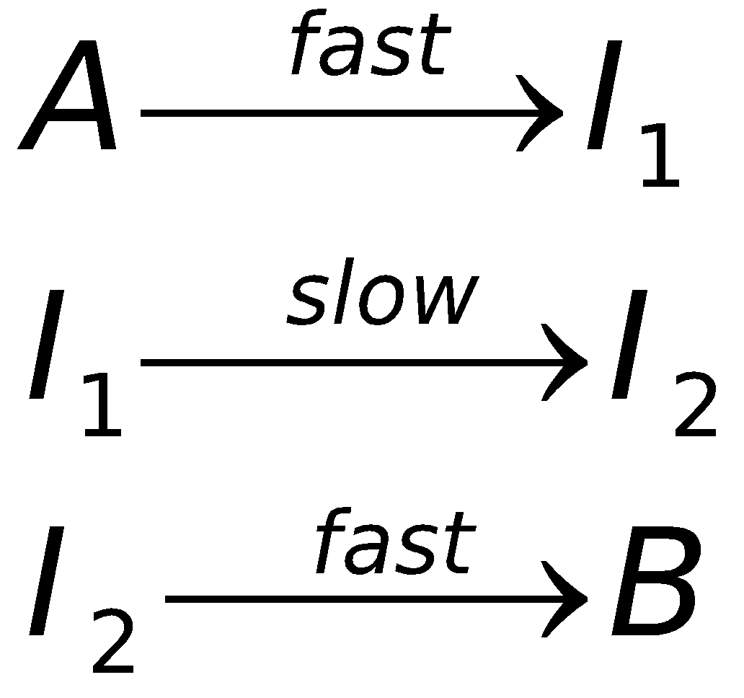
Considering the reaction A→B, it may consist of three intermediate steps:
Which step in this hypothetical reaction would have the greatest effect on the rate of reaction?

Slide 10
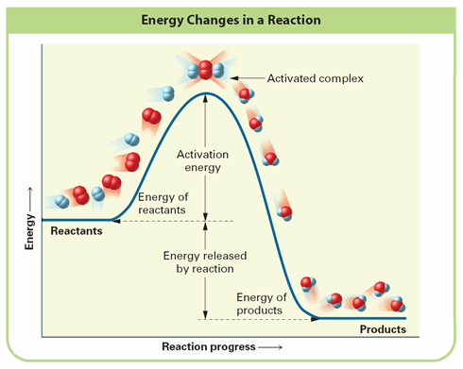
What is the effect of kinetic energy on reaction rates?
Colliding particles must have sufficient energy to react with other particles.
The minimum energy colliding particles must have to react is called the activation energy of a chemical reaction. This is usually represented diagrammatically.
2H₂(g) + O₂(g) 🡪 2H₂O(g)

Slide 11
Exothermic Energy Diagram
The activated complex is the arrangement of atoms at the peak of the activation energy barrier.
The lifespan of the activated complex is usually very small – 10⁻¹³ sec or so.
It is sometimes referred to as the transition state.

Slide 12
Exothermic Energy Diagram
In an exothermic reaction, the products have less energy than the reactants.
Heat is released in exothermic processes.

Slide 13
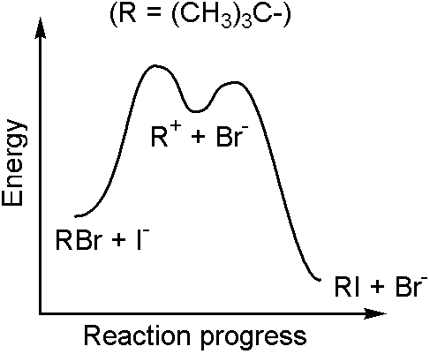
Why are some reactions slow?
Collision theory explains why some reactions like the formation of water or carbon dioxide from their elements are very slow – they have high activation energies, often with multiple steps.
At room temperature, molecular collisions are not energetic enough to overcome the activation energy barrier, so the reaction rate is close to zero.

Slide 14
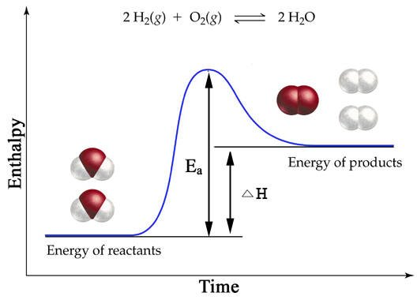
Endothermic Energy Diagram
In an endothermic reaction, the products have higher energy than the reactants
Endothermic reactions tend to have high activation energy (E_{a})

Slide 15
Reaction Rate Variables
Temperature
    temperature usually speeds up chemical reactions
    at high temperature, reactant particles are more chaotic and more energetic than at low temperatures
    high temperatures increase the likelihood that the kinetic energy barrier (activation energy) will be breeched.
    Frequency of collisions also increases

Slide 16
Increasing the temperature increases the rate of a reaction by
lowering the activation energy
increasing the activation energy
lowering the frequency of effective collisions between reacting molecules
increasing the frequency of effective collisions between reacting molecules

Slide 17
Reaction Rate Variables
Concentration
    the number of reacting particles in a given volume is a major contributor to the rate of chemical reactions
    more particles, more collisions
As the concentration of reacting particles increases, the rate of reaction generally
decreases
increases
remains the same

Slide 18
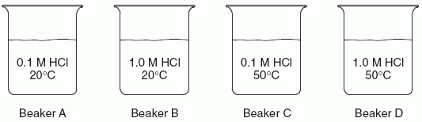
In each of the four beakers shown above, a 2.0-centimeter strip of magnesium ribbon reacts with 100 milliliters of HCl(aq) under the conditions shown.
In which beaker will the reaction occur at the fastest rate?
Beaker A
Beaker B
Beaker C
Beaker D

Slide 19
Reaction Rate Variables
Particle Size
    the total surface area of a solid or liquid is also very important
    smaller particle sizes have larger surface area per unit of mass
    larger surface areas have more collisions and higher reaction rates.
    Dissolving particles or grinding them into powder greatly increases reaction rates.
    Homogeneous mixtures of reactants react more quickly than heterogeneous mixtures. Why?

Slide 20
When a single 1-gram piece of zinc is added to 3 M hydrochloric acid at 25°C, the reaction is slow. Which procedure would most likely increase the rate of the reaction if the reaction were repeated?
using 1 gram of powdered zinc
using 1 M hydrochloric acid
decreasing the temperature to 20.°C
decreasing the concentration of the zinc

Slide 21
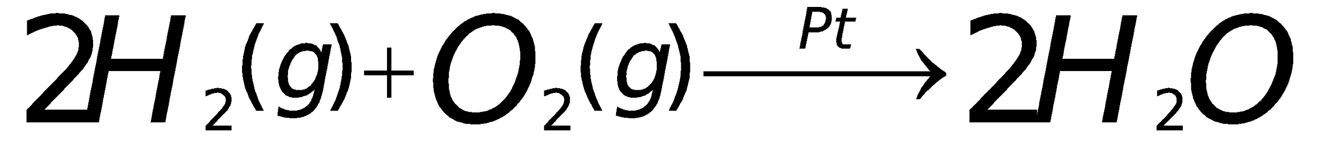
Reaction Rate Variables
Catalysts
    are substances that increase the rate of reaction without being chemically altered in the reaction
    they allow reactions to occur at a lower energy – they lower the activation energy of reactions
    For example the formation of water can be catalyzed by Pt. Catalysts are written in chemical equations above the arrow:

Slide 22
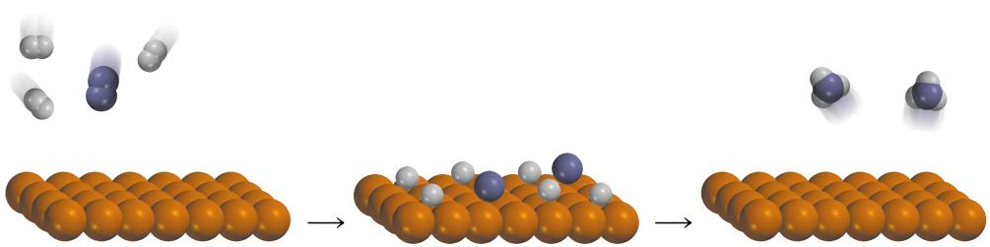
Haber Process
Fe/Al₂O₃/K₂O
N₂ (g) + 3H₂ (g) 2NH₃ (g)
catalyst
13.6

Slide 23
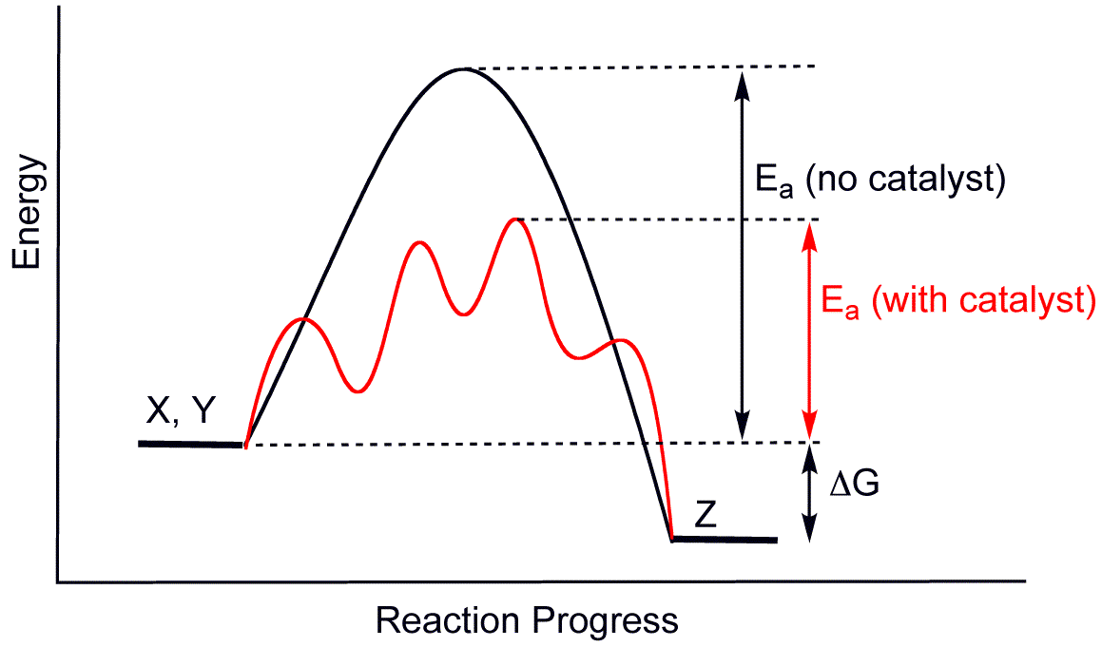
Catalysts and Energy Diagrams

Slide 24
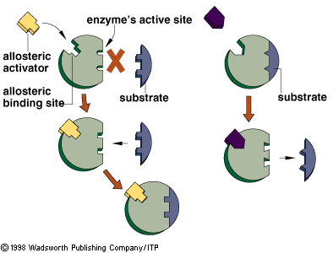
Proteins
    Many proteins (enzymes) catalyze reactions by providing the right surface (provided by the amino acid structure) for chemical reactions to occur.
    The proteins lower the activation energy, allowing our body to synthesize and break down many compounds that normally have high energy barriers preventing their formation

Slide 25
Inhibitors and Poisons
    inhibitors are substances that interfere with the action of a catalyst.
    Famous inhibitors of hemoglobin: HCN and CO
    HIV drugs (and many others) are inhibitors
    Pesticides – insecticides, herbicides, fungicides
    In biological systems, the products often inhibit their own formation (feedback inhibition)

Slide 26
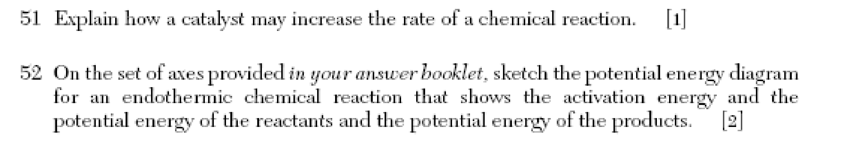
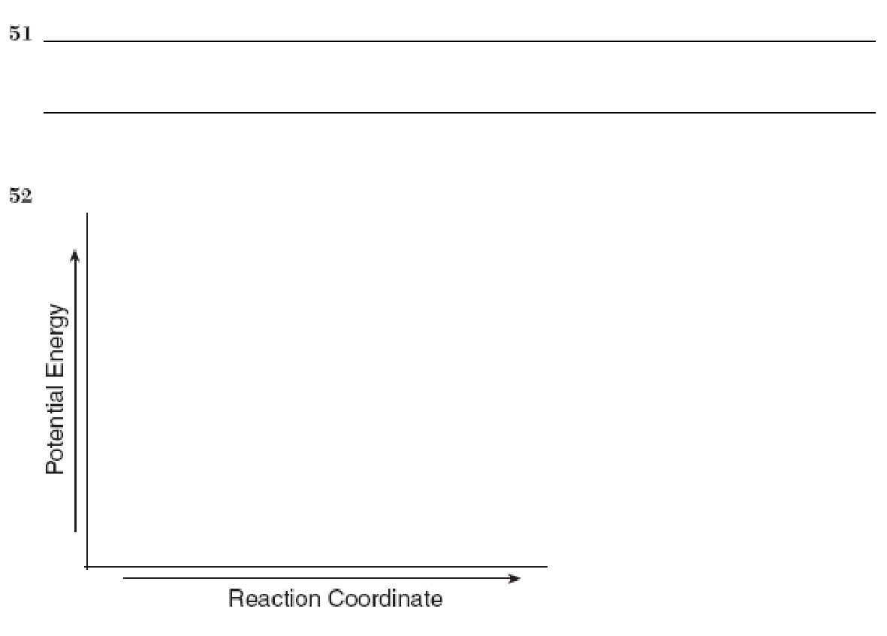

Slide 27
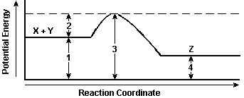
The potential energy diagram shows the reaction X + Y ↔ Z.
When a catalyst is added to the reaction, it will change the value of
1 and 2
1 and 3
2 and 3
3 and 4

Slide 28
A catalyst works by
increasing the potential energy of the reactants
increasing the energy released during a reaction
decreasing the potential energy of the products
decreasing the activation energy required for a reaction

Slide 29
Lab 15: Effect of Concentration on the Rate of a Chemical Reaction
Objective
We will study the effects of changing reactant concentration on the speed of a reaction.
The reaction involves combining sodium thiosulfate (Na₂S₂O₃) with hydrochloric acid (HCl).
The products of this reaction include colloidal sulfur (S), which causes the heterogeneous mixture to become cloudy.
By measuring the time it takes for print placed below a beaker to “disappear,” we can compare reaction rates under different conditions.

Slide 30
Materials
Na₂S₂O₃ and HCl solutions
50 ml beaker
timer
Beral pipets
three plastic cups

Slide 31
Procedure
Take three plastic cups and fill them with thiosulfate, water, and HCl, respectively. Make sure you clearly identify which substance is in each cup – they are all colorless!
Get a beral pipet for each cup. In a clean dry beaker, place one “squirt” of thiosulfate into the beaker.
Using a different pipet, place three squirts of water in the same beaker.
Place your beaker over a piece of paper with a letter clearly drawn. Get your timer ready.
Add a squirt of HCl and immediately begin timing. When the letter disappears, stop the time and write your time in the data table. Continue the process with different amounts of the thiosulfate solution, as directed by the table.

Slide 32
Squirts Thiosulfate | Squirts HCl | Squirts Water | Time (s)
1 | 1 | 3
2 | 1 | 2
4 | 1 | 0

